Slide 1
Neurons & Nervous Systems
AP Biology

Slide 2
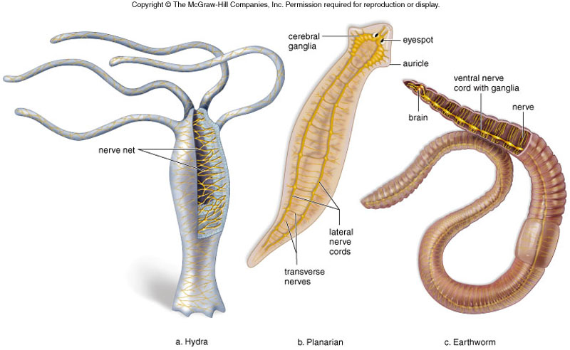
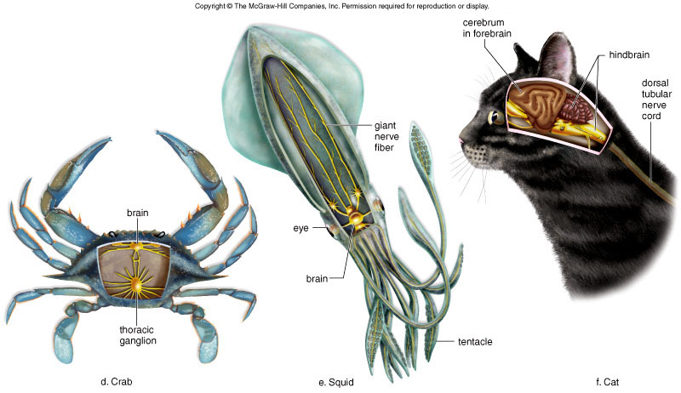

Slide 3
Vertebrate Nervous Organization
Central nervous system
Develops from an embryonic dorsal tubular nerve cord
Cephalization and bilateral symmetry result in several paired sensory receptors
Vertebrate brain is organized into three areas
Hindbrain
Midbrain
Forebrain

Slide 4
Nervous system has three specific functions
Receiving sensory input
Performing integration
Generating motor output

Slide 5
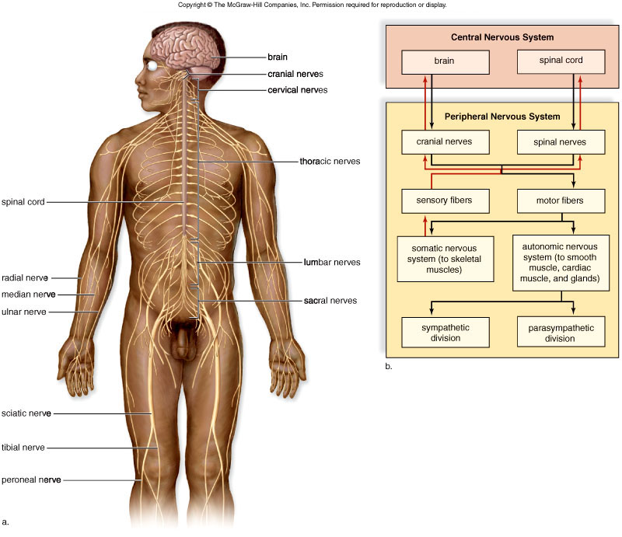
Organization of the Human Nervous System

Slide 6
Human Nervous System
Central nervous system (CNS)
Includes the brain and spinal cord
Lies in the midline of the body
The peripheral nervous system (PNS)
Contains cranial nerves and spinal nerves that
Gather info from sensors and conduct decisions to effectors
Lies outside the CNS

Slide 7
Nervous Tissue
Neurons
Cell body contains nucleus
Dendrites receive signals from sensory receptors
Axon conducts nerve impulses
Covered by myelin sheath
Any long axon is also called a nerve fiber

Slide 8
Types of Neurons
Motor Neurons
Accept nerve impulses from the CNS
Transmit them to muscles or glands
Sensory Neurons
Accept impulses from sensory receptors
Transmit them to the CNS
Interneurons
Convey nerve impulses between various parts of the CNS

Slide 9
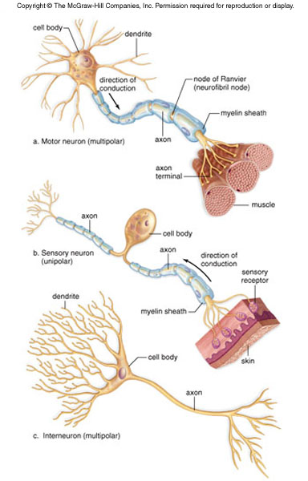
Neuron Anatomy

Slide 10
Resting Potential
The membrane potential (voltage) when the axon is not conducting an impulse
The inside of a neuron is more negative than the outside -65 mV
Due in part to the action of the sodium-potassium pump

Slide 11
Action Potential
An action potential is generated only after a stimulus larger than the threshold
Gated channel proteins
Suddenly allows sodium to pass through the membrane
Another allows potassium to pass through other direction

Slide 12
Propagation of Action Potentials
In myelinated fibers, an action potential at one node causes an action potential at the next node
Saltatory (jumping) Conduction
Conduction of a nerve impulse is an all-or-nothing event
Intensity of signal is determined by how many impulses are generated within a given time span

Slide 13
Transmission Across a Synapse
A synapse is a region where neurons nearly touch
Small gap between neurons is the synaptic cleft
Transmission across a synapse is carried out by neurotransmitters
Sudden rise in calcium at end of one neuron
Stimulates synaptic vesicles to merge with the presynaptic membrane
Neurotransmitter molecules are released into the synaptic cleft

Slide 14
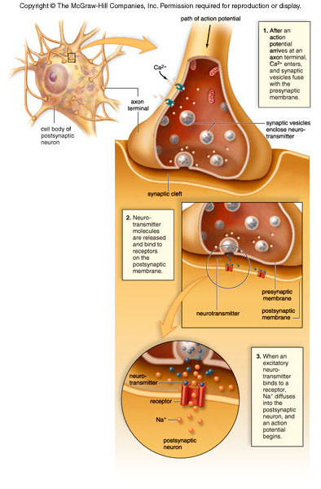
Synapse Structure and Function

Slide 15
Synaptic Integration
A single neuron is on the receiving end of
Many excitatory signals, and
Many inhibitory signals
Integration
The summing of signals from
Excitatory signals, and
Inhibitory signals

Slide 16
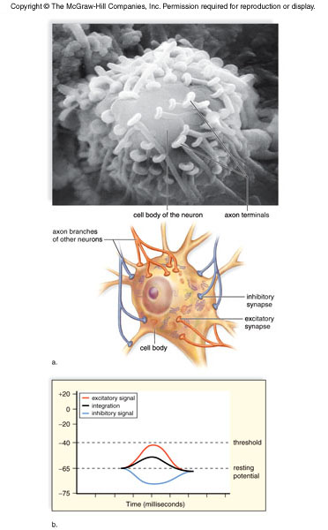
Synapse Integration

Slide 17
CNS: Brain and Spinal Cord
Spinal cord and brain are wrapped in three protective membranes, meninges
Spaces between meninges are filled with cerebrospinal fluid
Fluid is continuous with that of central canal of spinal cord and the ventricles of the brain

Slide 18
Spinal Cord
The spinal cord has two main functions
Center for many reflex actions
Means of communication between the brain and spinal nerves
The spinal cord is composed of gray matter and white matter
Cell bodies and short unmyelinated fibers give the gray matter its color
Myelinated long fibers of interneurons running in tracts give white matter its color

Slide 19
The Brain
Cerebrum is the largest portion of the brain in humans
Communicates with, and coordinates the activities of, the other parts of the brain
Longitudinal fissure divides into left and right cerebral hemispheres

Slide 20
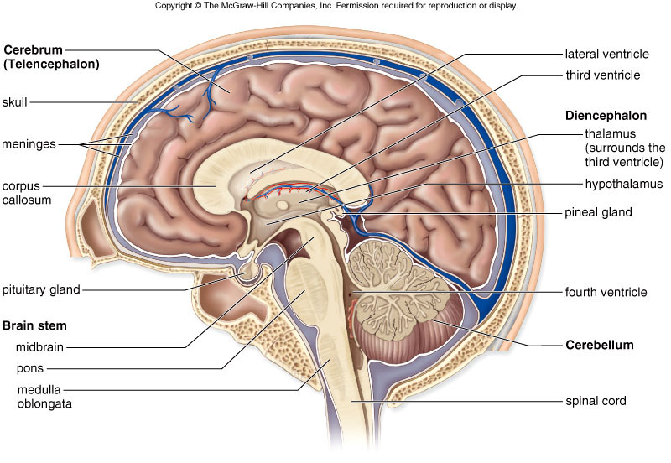
The Human Brain

Slide 21
Cerebral Cortex
A thin but highly convoluted outer layer of gray matter
Covers the cerebral hemispheres
Contains motor areas and sensory areas as well as association areas
Primary motor area is in the frontal lobe just ventral to central sulcus
Primary somatosensory area is just dorsal to central sulcus

Slide 22
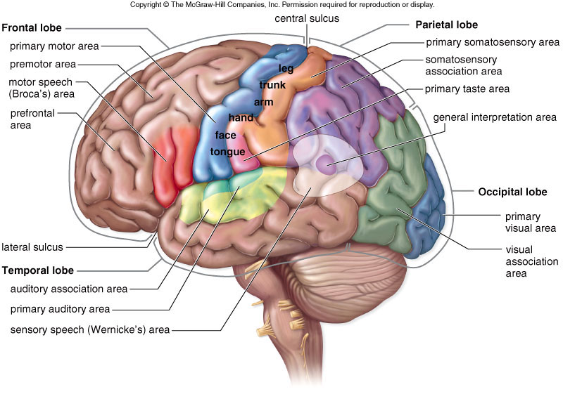
The Lobes of a Cerebral Hemisphere

Slide 23
Cerebrum
Rest of cerebrum is composed of white matter
Descending tracts communicate with lower brain centers
Ascending tracts send sensory information to primary somatosensory area
Basal nuclei
Integrate motor commands
Ensure that the proper muscle groups are either activated or inhibited

Slide 24
Diencephalon
A region encircling the third ventricle
Consists of hypothalamus and thalamus
Hypothalamus forms floor of the third ventricle
Thalamus consists of two masses of gray matter located in the sides and roof of the third ventricle
Pineal gland
Also located in the diencephalon
Secretes melatonin

Slide 25
Cerebellum
Separated from the brain stem by the fourth ventricle
Receives sensory input from the eyes, ears, joints, and muscles
Sends motor impulses out the brain stem to the skeletal muscles

Slide 26
Brain Stem
Contains the midbrain, the pons, and the medulla oblangata
Midbrain
Acts as a relay station for tracts passing between
The cerebrum, and
The spinal cord or cerebellum
Pons
Helps regulate breathing and head movements
Medulla oblongata
Contains reflex centers for vomiting, coughing, sneezing, hiccuping, and swallowing

Slide 27
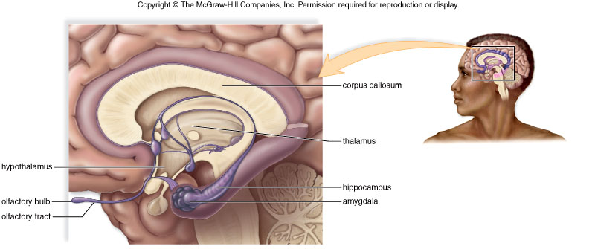
The Limbic System
Notes:
Complex network of tracts and “nuclei”
Incorporates medial portions of
The cerebral lobes,
The subcortical basal nuclei, and
The dicenephalon
Integrates higher mental functions and primitive emotions
Hippocampus
Amygdala

Slide 28
The limbic system is a complex set of structures that lies on both sides of the thalamus, just under the cerebrum. It includes the hypothalamus, the hippocampus, the amygdala, and several other nearby areas. It appears to be primarily responsible for our emotional life, and has a lot to do with the formation of memories

Slide 29
Peripheral Nervous System
Somatic system
Contains cranial nerves and spinal nerves
Gather info from sensors and conduct decisions to effectors
Controls the skeletal muscles
Conscious of its activity
Autonomic system
Controls the smooth muscles, cardiac muscles, and glands
Usually unaware of its actions
Divided into two divisions
Sympathetic division
Parasympathetic division

Slide 30
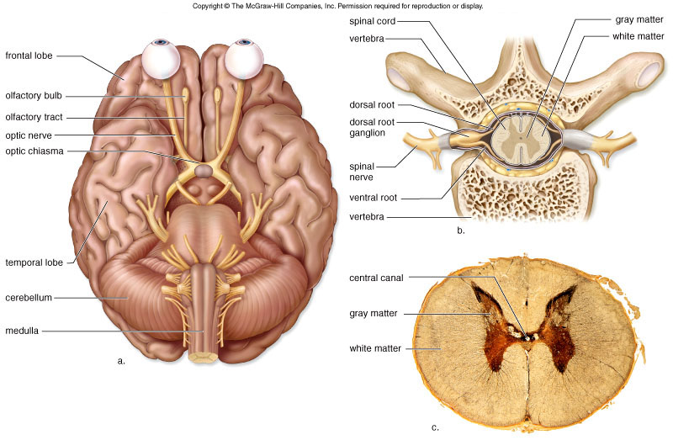
Cranial and Spinal Nerves

Slide 31
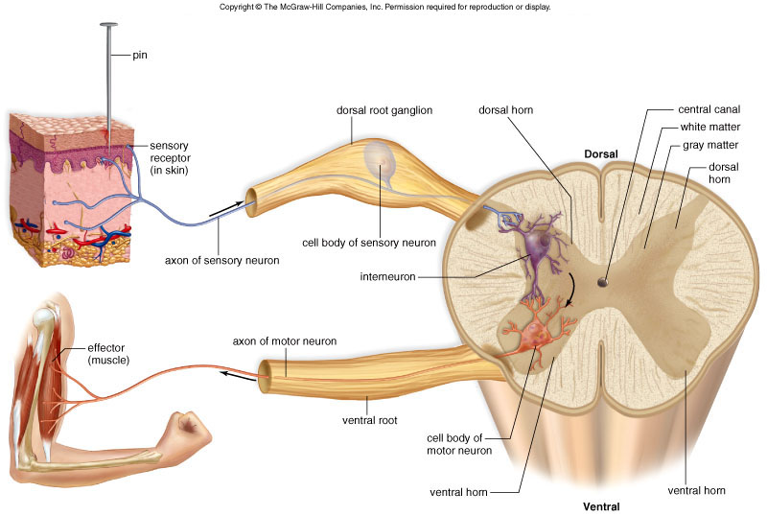
A Reflex Arc Showing the Path of a Spinal Reflex

Slide 32
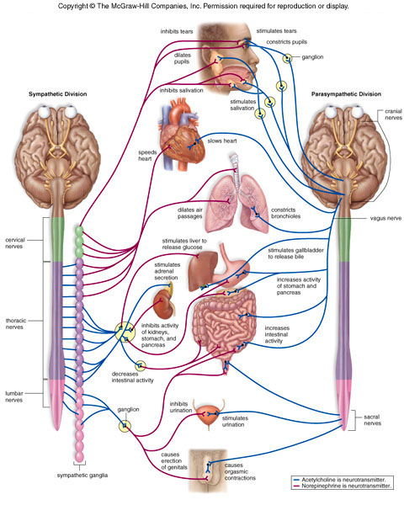
Autonomic System Structure and Function

